Slide 1

Styling
With CSS
#1 Basic Style

Slide 2


Front-End Development
Front end development is the development of code that creates the visual front-end elements of a software, application or website. Front end languages include HTML, CSS, and Javascript
HTML defines the content of web pages
CSS specifies the layout of web pages
JS programs the behavior of web pages

Slide 3
CSS (Cascading Style Sheets) describes how HTML elements are to be displayed on screen, paper, or in other media.
CSS saves a lot of work. It can control the layout of multiple web pages all at once. External stylesheets are better stored in CSS files separately.

Slide 4
Inline Styles
<!DOCTYPE html>
<html>
<head>
<title>CSS Styles</title>
</head>
<body>
<h1 style="color:red">Hai!</h1>
</body>
</html>

Slide 5
Internal Styles
<!DOCTYPE html>
<html>
<head>
<title>CSS Styles</title>
<style>
h2 {
color: green;
}
</style>
</head>
<body>
<h2>Halo!</h2>
</body>
</html>

Slide 6
External Styles
style.css
p {
color: blue;
}
index.html
<!DOCTYPE html><html><head>
<title>CSS Styles</title>
<link rel="stylesheet"
type="text/css"
href="style.css">
</head><body>
<p>Ini paragraf.</p>
</body></html>

Slide 7
Selector
telling CSS which
elements to style
<!DOCTYPE html>
<html>
<head>
<style>
h2 {color: orange;}
p {color: red;}
.mobil {color: blue;}
#avanza {color: greenyellow}
</style>
</head>
<body>
<h2>Halo</h2>
<p>Hai</p>
<p class="mobil" id="avanza">Ini Avanza</p>
<p class="mobil" id="alya">Ini Alya</p>
</body>
</html>

Slide 8
Selector
telling CSS which
elements to style
h2 {color: orange;}
p {color: red;}
.mobil {color: blue;}
#avanza {color: greenyellow}
h2, p, .mobil & #avanza are called Selectors.
{color: orange;} are Property & Value.
To select an element to style, simply:
call its tag e.g h2 {color: orange;}
call its class e.g .mobil {color: blue;}
call its id e.g #avanza {color: green;}

Slide 9
Attribute Selector
<!DOCTYPE html>
<html>
<head>
<style>
a[href] {color: red;}
</style>
</head>
<body>
<p><a href="#">Ini link</a>
</body>
</html>

Slide 10
Grouping
<head><style>
h1, h2, p {
color: blueviolet;
font-family: Impact;
}
</style></head><body>
<h1>Contoh Grouping</h1>
<h2>Tiga elemen,</h2>
<p>Satu style.</p>
</body>

Slide 11
Descendant Selector
<head><style>
main h2 {
color: red;
font-family: Impact;
}
header h2, footer h2 {
color: green;
font-family: Arial;
}
</style></head><body>
<header><h2>Ini header</h2></header>
<main><h2>Ini konten</h2></main>
<footer><h2>Ini footer</h2></footer>
</body>

Slide 12
Child Selector
<head><style>
main > p {
color: red;
font-family: Impact;
font-size: 30px
}
</style></head><body>
<main>
<p>di dalam main</p>
<div>
<p>dalam div dalam main</p>
</div>
</main>
</body>

Slide 13
Child Selector
<head><style>
main > div > p {
color: red;
font-family: Impact;
font-size: 30px
}
</style></head><body>
<main>
<p>di dalam main</p>
<div>
<p>dalam div dalam main</p>
</div>
</main>
</body>

Slide 14
Adjacent Selector
<head><style>
h1 + p {
color: red;
font-family: Impact;
font-size: 30px
}
</style></head><body>
<h1>Ini header</h1>
<p>Ini paragraf 1</p>
<p>Ini paragraf 2</p>
<p>Ini paragraf 3</p>
</body>

Slide 15
Adjacent Selector
<head><style>
h1 + p + p {
color: red;
font-family: Impact;
font-size: 30px
}
</style></head><body>
<h1>Ini header</h1>
<p>Ini paragraf 1</p>
<p>Ini paragraf 2</p>
<p>Ini paragraf 3</p>
</body>

Slide 16
Color
<!DOCTYPE html>
<html>
<head>
<style>
body {background-color: yellow;}
h1 {color: rgb(0, 0, 255);}
h2 {color: #00FF00;}
p {color: hsl(360, 100%, 75%);}
</style>
</head>
<body>
<h1>Selamat datang!</h1>
<h2>Purwadhika</h2>
<p>Startup & Coding School<p>
</body>
</html>

Slide 17
Color
body {background-color: yellow;}
h1 {color: rgb(0, 0, 255);}
h2 {color: #00FF00;}
p {color: hsl(360, 100%, 75%);}
Red, Green, Blue Color Values
{color: rgb(0, 0, 255);}
Hexadecimal Value
{color: #00FF00;}
Hue, Saturation, Lightness Value
{color: hsl(360, 100%, 75%);}
Alpha Transparency
{color: rgba(0, 0, 255, 0.782);}
{color: hsla(360, 100%, 75%, 0.5);}

Slide 18
<head><style>
body {
background-color:blue;
//background:
linear-gradient(blue,yellow);
//background:
linear-gradient(90deg,blue,yellow);
//background:
radial-gradient(blue,yellow);
}
</style></head>
<body></body>
Backgrounds
Color

Slide 19
Background
Image
<!DOCTYPE html>
<html>
<head>
<style>
body {
background-color: lightgray;
background: url("lin.jpg");
background-position: left top;
background-size: 1280px 720px;
}
</style>
</head>
<body>
</body>
</html>

Slide 20
<head><style>
p {
font-family: "Impact", Arial;
font-style: italic;
text-transform: uppercase;
text-decoration: line-through;
text-shadow: -4px 4px 4px red;
line-height: 50%;
letter-spacing: 2px;
word-spacing: 4px;
text-align: left;
text-indent: 2rem;
}
</style></head>
<body><p>halo kamu!<p></body>
</html>
Font &
Text

Slide 21
Font & Text
font-family (web safe fonts):
Arial, Helvetica, Times New Roman, Times, Courier New, Courier, Verdana, Georgia, Palatino, Garamond, Bookman, Comic Sans MS, Trebuchet MS, Arial Black, Impact
font-style:
normal, italic, oblique
text-transform:
capitalize, uppercase, lowercase, none
text-decoration:
underline, overline, line-through, wavy, none
text-align:
left, center, right

Slide 22
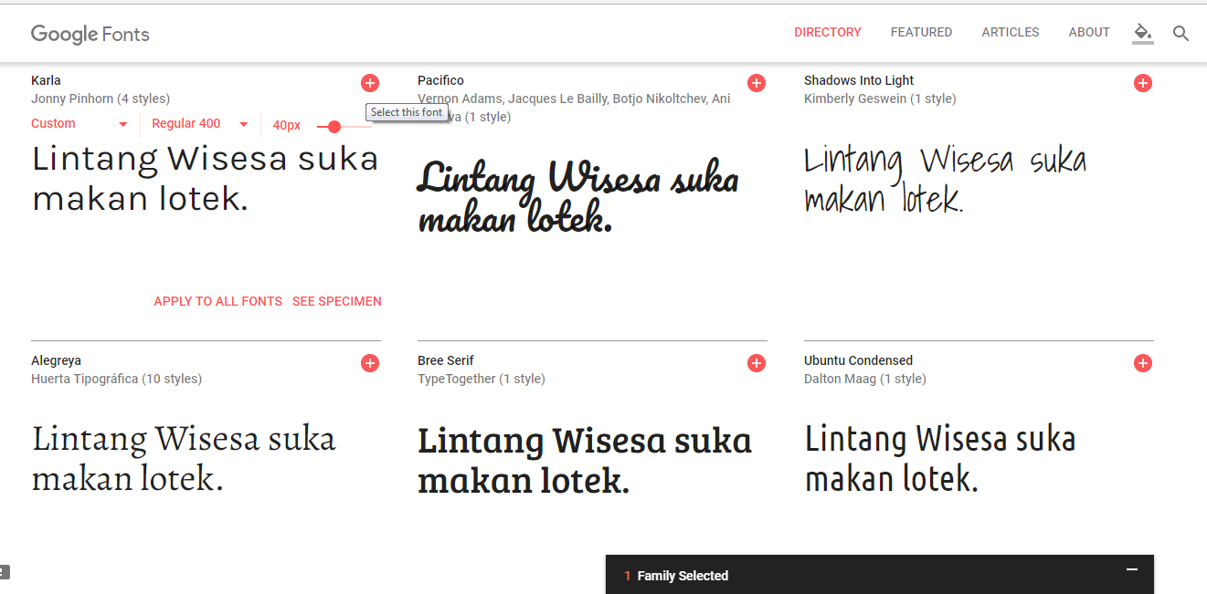
Google Fonts
fonts.google.com

Slide 23
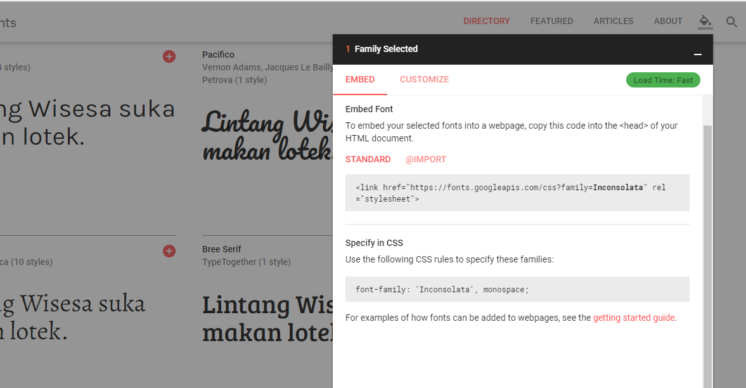
Google Fonts
fonts.google.com

Slide 24
Google Fonts
<head>
<link href=
'https://fonts.googleapis.com/css?family=Tangerine|Sofia'
rel='stylesheet'>
<style>
h1 {
font-family: 'Sofia';font-size: 50px;
}
h2 {
font-family: 'Tangerine';font-size: 50px;
}
</style>
</head>
<body>
<h1>Ini Font Sofia</h1>
<h2>Ini Font Tangerine</h2>
</body>

Slide 25
Lists
<head><style>
ul {
list-style-type: none;
}
</style></head>
<body>
<ul>
<li>List #1</li>
<li>List #2</li>
<li>List #3</li>
</ul>
</body>
list-style-type:
decimal, decimal-leading-zero, unset, lower-roman, upper-roman, square, etc.

Slide 26
Width & Height
<head><style>
.konten {
background-color: pink;
width: 200px;
height: 100px
}
</style></head>
<body>
<div class="konten">
Halo semuanya!
</div>
</body>

Slide 27
Unit Length
Absolute Lengths
px: the unit for pixels
pt: the unit for points
cm: the unit for centimeters
mm: the unit for millimeters
in: the unit for inches
pc: the unit for picas
Relative Lengths
%: the unit for percentages
em: relative to current font size
rem: relative to current font size on the element
vw: relative to the width of viewport divided by 100
vh: relative to the height of viewport/100
vmin: relative to the smaller viewport's dimension/100
vmax: relative to the larger viewport's dimension/100
ch: relative to 0
ex: relative to the x-height of font

Slide 28
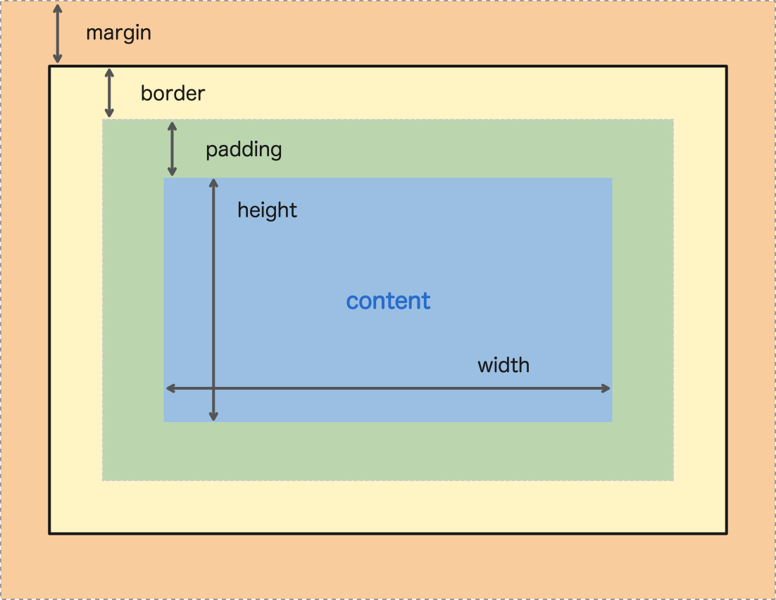
Padding, Border & Margin

Slide 29
<head><style>
div {
background-color: lightblue;
}
.tanpa-padding {
padding: 0;
}
.pakai-padding {
padding: 25px;
}
</style></head>
<body>
<div class="tanpa-padding">Tanpa padding</div>
<br>
<div class="pakai-padding">Pakai padding</div>
</body>
Padding

Slide 30
Padding
<head><style>
div {
background-color: lightblue;
width: 900px;
height: 500px;
}
h1 {
color: white;
background-color: blue;
padding-top: 10px;
padding-bottom: 20px;
padding-left: 25px;
padding-right: 30px;
}
</style></head><body>
<div><h1>Ini Padding</h1></div>
</body>

Slide 31
<head><style>
div {
background-color: lightblue;
width: 900px; height: 500px;
}
h1 {
color: white; background-color: blue;
padding: 25px;
border: 20px ridge yellow;
border-radius: 10px;
box-shadow: -0.5rem 0.5rem 1rem gray;
}
</style></head><body>
<div><h1>Contoh Border</h1></div>
</body>
Border styles:
solid, dotted, dashed, double, inset,
outset, groove, ridge
Border

Slide 32
<head><style>
div {
background-color: lightblue;
width: 900px; height: 500px;
margin-left: 200px;
}
h1 {
color: white; background-color: blue;
padding: 25px;
border: 20px ridge yellow;
}
</style></head><body>
<div><h1>Contoh Border</h1></div>
</body>
Margin:
margin-top, margin-bottom, margin-right
Margin

Slide 33
Padding, Border & Margin

Slide 34
2D Transforms
y
x

Slide 35
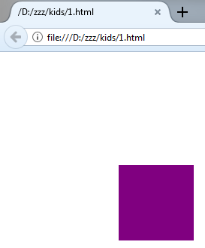
<head><style>
.box {
height: 100px;
width: 100px;
margin: 50px;
background-color: purple;
transform: translate(100px, 100px);
}
</style>
</head>
<body>
<div class="box"></div>
</body>
</html>
2D Transforms
Translate

Slide 36
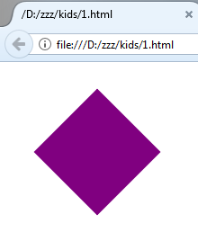
2D Transforms
Rotate
<head><style>
.box {
height: 100px;
width: 100px;
margin: 50px;
background-color: purple;
transform: rotate(45deg);
}
</style>
</head>
<body>
<div class="box"></div>
</body>
</html>

Slide 37
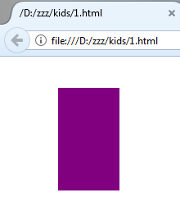
2D Transforms
Scale
<head><style>
.box {
height: 100px;
width: 100px;
margin: 50px;
background-color: purple;
transform: scale(0.75, 1.25);
}
</style>
</head>
<body>
<div class="box"></div>
</body>
</html>

Slide 38
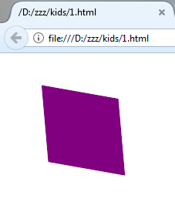
2D Transforms
Skew
<head><style>
.box {
height: 100px;
width: 100px;
margin: 50px;
background-color: purple;
transform: skew(5deg, 10deg);
}
</style>
</head>
<body>
<div class="box"></div>
</body>
</html>

Slide 39
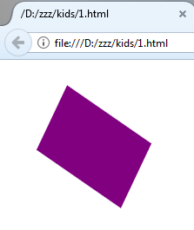
<head><style>
.box {
height: 100px;
width: 100px;
margin: 50px;
background-color: purple;
transform: skew(15deg, 7deg)
rotate(125deg);
}
</style>
</head>
<body>
<div class="box"></div>
</body>
</html>
2D Transforms
Multiple Transforms

Slide 40
3D Transforms
y
.
x
z

Slide 41
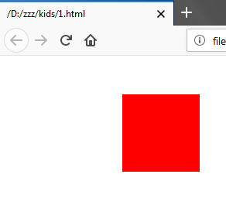
<head><style>
.box {
width: 100px;
height: 100px;
margin: 50px;
background-color: red;
transform: perspective(700px)
translateX(100px);
}
</style></head>
<body>
<div class="box"></div>
</body>
3D Transforms
Translate X

Slide 42
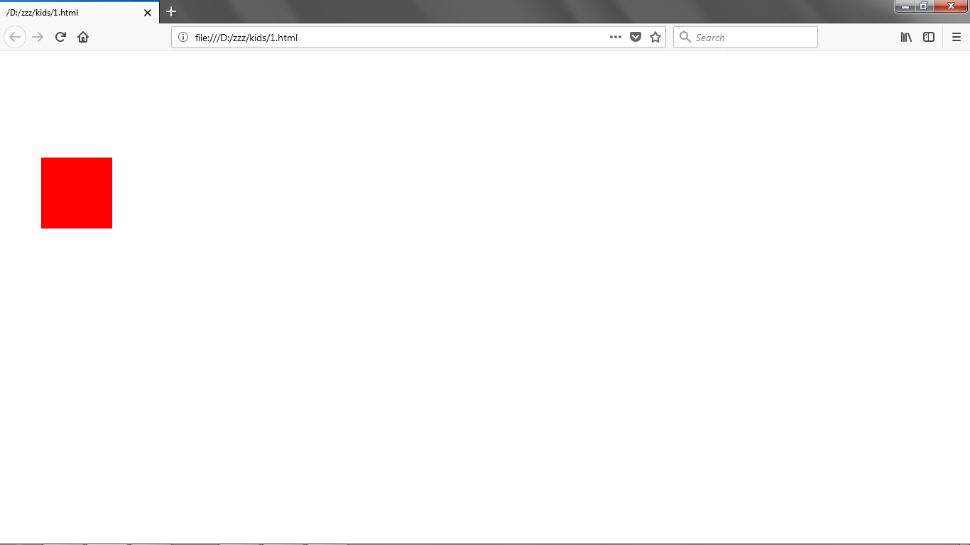
<head><style>
.box {
width: 100px;
height: 100px;
margin: 50px;
background-color: red;
transform: perspective(700px)
translateY(100px);
}
</style></head>
<body>
<div class="box"></div>
</body>
3D Transforms
Translate Y

Slide 43
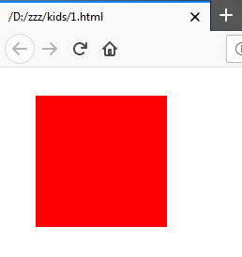
<head><style>
.box {
width: 100px;
height: 100px;
margin: 50px;
background-color: red;
transform: perspective(700px)
translateZ(200px);
}
</style></head>
<body>
<div class="box"></div>
</body>
3D Transforms
Translate Z

Slide 44
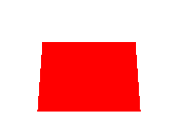
<head><style>
.box {
width: 100px;
height: 100px;
margin: 50px;
background-color: red;
transform: perspective(700px)
rotateX(45deg);
}
</style></head>
<body>
<div class="box"></div>
</body>
3D Transforms
Rotate X

Slide 45
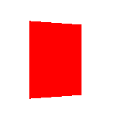
<head><style>
.box {
width: 100px;
height: 100px;
margin: 50px;
background-color: red;
transform: perspective(700px)
rotateY(45deg);
}
</style></head>
<body>
<div class="box"></div>
</body>
3D Transforms
Rotate Y

Slide 46
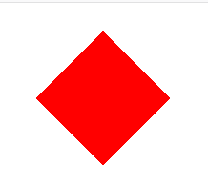
<head><style>
.box {
width: 100px;
height: 100px;
margin: 50px;
background-color: red;
transform: perspective(700px)
rotateZ(45deg);
}
</style></head>
<body>
<div class="box"></div>
</body>
3D Transforms
Rotate Z

Slide 47
Styling
With CSS
#1 Basic Style

